Slide 1
Early Fire Detection System

Slide 2
Implementation Report
We are going to use TensorFlow API Keras for building our model. Keras is an open-source neural network library written in Python. We first created our ImageDataGenerator for labeling our data. Training and Validation datasets are used here for training. Finally, we will have 980 images for training and 239 images for validation. We are going to use data augmentation as well.

Slide 3
import tensorflow as tf
import keras_preprocessing
from keras_preprocessing import image
from keras_preprocessing.image import ImageDataGenerator
import shutil
TRAINING_DIR = "Training"
training_datagen = ImageDataGenerator(rescale = 1./255,
horizontal_flip=True,
rotation_range=30,
height_shift_range=0.2,
fill_mode='nearest')
VALIDATION_DIR = "Validation"
validation_datagen = ImageDataGenerator(rescale = 1./255)

Slide 4

train_generator = training_datagen.flow_from_directory(
TRAINING_DIR,
target_size=(224,224),
class_mode='categorical',
batch_size = 64
)
validation_generator = validation_datagen.flow_from_directory(
VALIDATION_DIR,
target_size=(224,224),
class_mode='categorical',
batch_size= 16
)
Output:

Slide 5
In the above code, 3 data augmentation techniques are applied — horizontal flipping, rotation, and height shifting.During training, we set the number of epochs and batch size to 50 and 64,respectively.

Slide 6
Horizontal Flippling
Horizontal axis flipping is much more common than flipping the vertical axis. This augmentation is one of the easiest to implement and has proven useful on datasets such as CIFAR-10 and ImageNet. On datasets involving text recognition such as MNIST or SVHN, this is not a label-preserving transformation.
Rotation
Rotation augmentations are done by rotating the image right or left on an axis between 1° and 359°. The safety of rotation augmentations is heavily determined by the rotation degree parameter. Slight rotations such as between 1 and 20 or −1 to −20 could be useful on digit recognition tasks such as MNIST, but as the rotation degree increases, the label of the data is no longer preserved post-transformation.
Height-Shifting
Cropping images can be used as a practical processing step for image data with mixed height and width dimensions by cropping a central patch of each image. Additionally, random cropping can also be used to provide an effect very similar to translations. The contrast between random cropping and translations is that cropping will reduce the size of the input such as (256,256)→(224, 224), whereas translations preserve the spatial dimensions of the image.

Slide 7
The model is customized basic CNN architecture inspired by AlexNet architecture.
The AlexNet model is constructed with five convolutional layers, and a max-pooling operation is applied after the convolutional layers. The output of the last two fully connected layers feeds data into thousand-way units to produce a probability distribution among thousands of classes of labels.

Slide 8
Then we created our CNN model. The model contains three Conv2D-MaxPooling2D layers pairs followed by 3 Dense layers. To overcome the problem of overfitting we will also add dropout layers. The last layer is the softmax layer which will give us the probability distribution for both the classes — Fire and Nonfire.After each convolutional layer, we employed a max-pooling layer for down sampling purposes. Max pooling has been proved to be more effective than average pooling for computer vision tasks such as classification, segmentation, and object detection.

Slide 9
We employed a rectified linear unit (ReLU) as the activation function after all four convolutional layers.The advantage of a ReLU is that its processing speed is higher than those of other nonlinear activation functions; in addition, a ReLU does not experience the gradient vanishing problem, because the gradient of the ReLU function is either 0 or 1, which means it never saturates, and so the gradient vanishing problem does not occur.We have also used softmax activation function which converts a vector of values to a probability distribution.

Slide 10
from tensorflow.keras.optimizers import RMSprop,Adam
model = tf.keras.models.Sequential([
tf.keras.layers.Conv2D(96, (11,11), strides=(4,4), activation='relu',input_shape=(224, 224, 3)),
tf.keras.layers.MaxPooling2D(pool_size = (3,3), strides=(2,2)),
tf.keras.layers.Conv2D(256, (5,5), activation='relu'),
tf.keras.layers.MaxPooling2D(pool_size = (3,3), strides=(2,2)),
tf.keras.layers.Conv2D(384, (5,5), activation='relu'),
tf.keras.layers.MaxPooling2D(pool_size = (3,3), strides=(2,2)),
tf.keras.layers.Flatten(),
tf.keras.layers.Dropout(0.2),
tf.keras.layers.Dense(2048, activation='relu'),
tf.keras.layers.Dropout(0.25),
tf.keras.layers.Dense(1024, activation='relu'),
tf.keras.layers.Dropout(0.2),
tf.keras.layers.Dense(2, activation='softmax')
])
model.compile(loss='categorical_crossentropy',
optimizer=Adam(lr=0.0001),
metrics=['acc'])
model.summary()

Slide 11
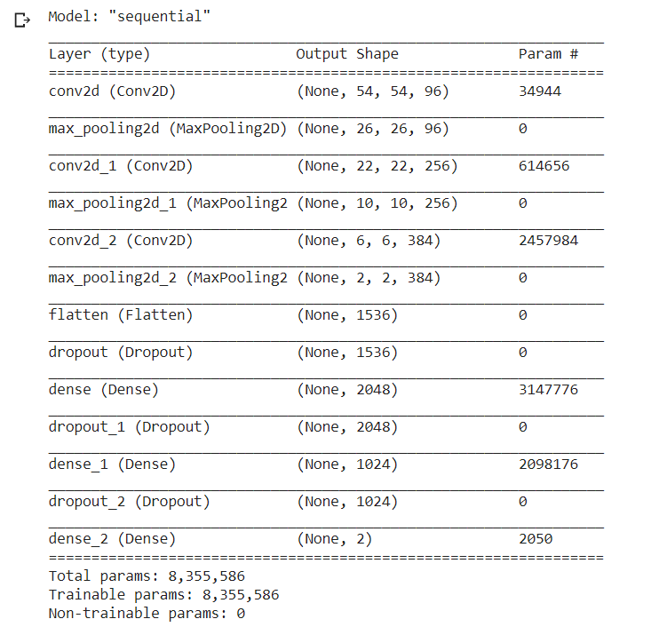
Output:

Slide 12
After training for 50 epochs, we get the training accuracy of 96.83 and validation accuracy of 94.98. The training and validation loss is 0.09 and 0.13 respectively.
history = model.fit(
train_generator,
steps_per_epoch = 5,
epochs = 5,
validation_data = validation_generator,
validation_steps = 15
#callbacks=[callbacks]
)

Slide 13
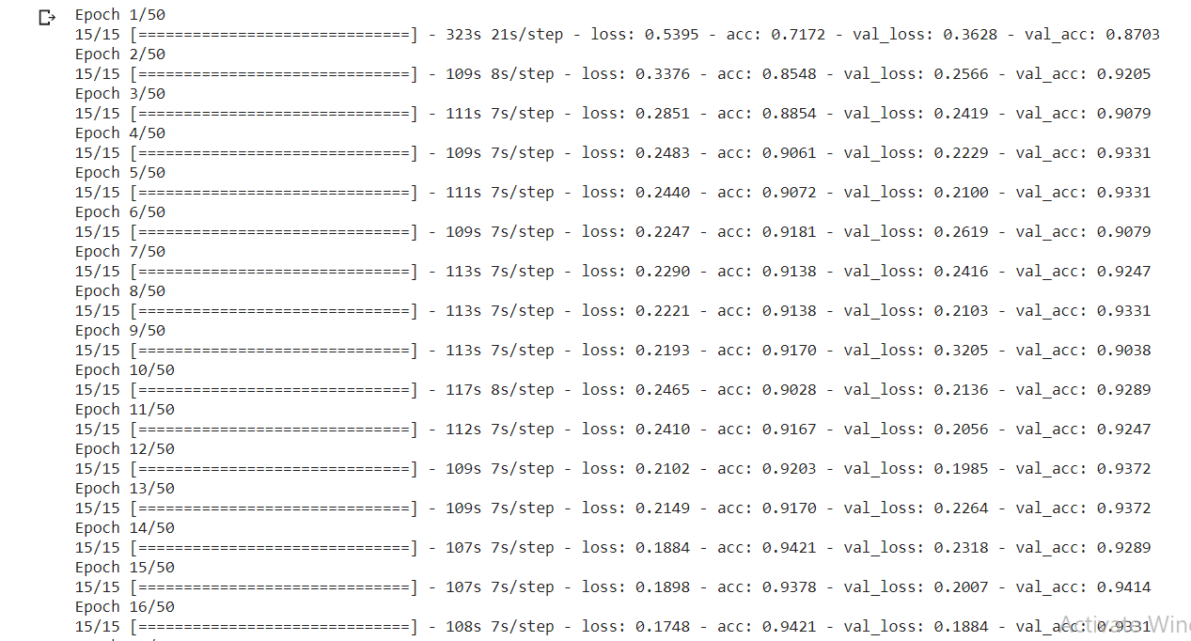

Slide 14
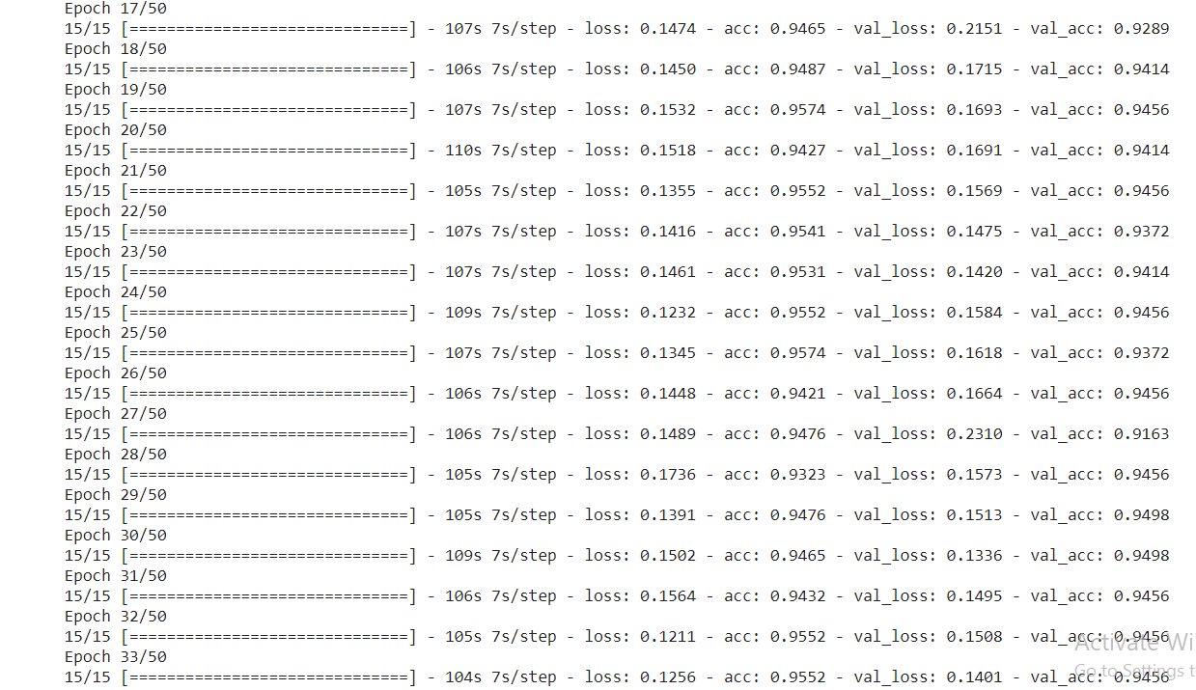

Slide 15
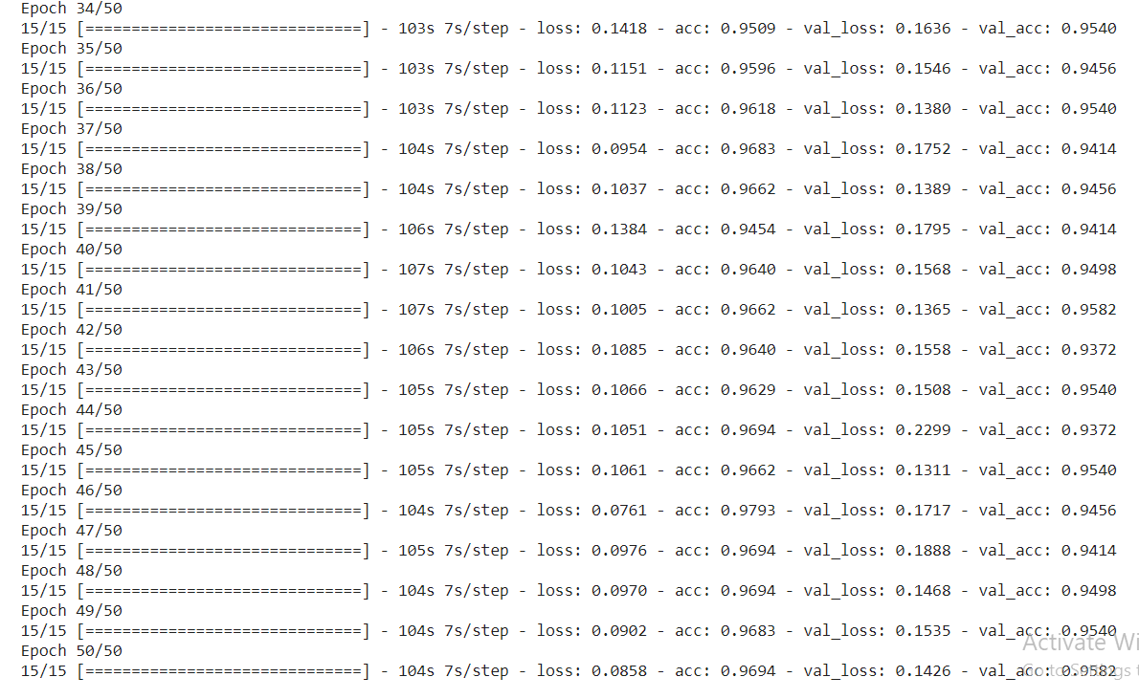

Slide 16
We used Adam as an optimizer with a learning rate of 0.0001. Adaptive Moment Estimation(Adam) is an algorithm for optimization technique for gradient descent. The method is really efficient when working with large problem involving a lot of data or parameters. It requires less memory and is efficient. Intuitively, it is a combination of the ‘gradient descent with momentum’ algorithm and the ‘RMSP’ algorithm.

Slide 17
%matplotlib inline
import matplotlib.pyplot as plt
acc = history.history['acc']
val_acc = history.history['val_acc']
loss = history.history['loss']
val_loss = history.history['val_loss']
epochs = range(len(acc))
plt.plot(epochs, acc, 'g', label='Training accuracy')
plt.plot(epochs, val_acc, 'b', label='Validation accuracy')
plt.title('Training and validation accuracy')
plt.legend(loc=0)
plt.figure()
plt.show()

Slide 18
plt.plot(epochs, loss, 'r', label='Training loss')
plt.plot(epochs, val_loss, 'orange', label='Validation loss')
plt.title('Training and validation loss')
plt.legend(loc=0)
plt.figure()
plt.show()

Slide 19
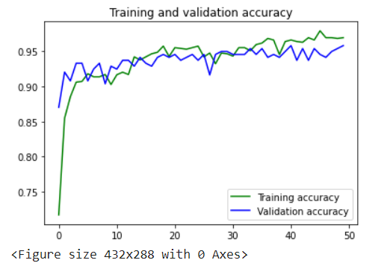
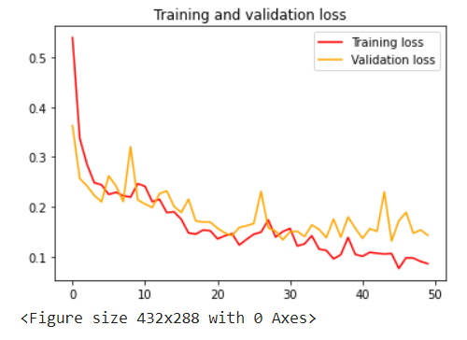

Slide 20
Predicting any random image
import numpy as np
from google.colab import files
from keras.preprocessing import image
uploaded = files.upload()
for fn in uploaded.keys():
path = '/content/drive/MyDrive/Early-Fire-Detection/' + fn
img = image.load_img(path, target_size=(224, 224))
x = image.img_to_array(img)
x = np.expand_dims(x, axis=0) /255
classes = model.predict(x)
print(np.argmax(classes[0])==0, max(classes[0]))

Slide 21


Slide 22
Comparison with Research Paper model
The model is constructed on the basis of dilated convolutions, and its performance was evaluated with respect to the following well-known architectures: AlexNet , VGGNet, ResNet50 , and Inception V3. In 2012, Alex Krizhevsky published work that was a turning point for vision-related tasks in deep learning. This work was an advanced variant of LeNet and became a winner of the ImageNet LSVRC-2012 competition. The AlexNet model is constructed with five convolutional layers, and a max-pooling operation is applied after the convolutional layers. The output of the last two fully connected layers feeds data into thousand-way units to produce a probability distribution among thousands of classes of labels.

Slide 23
After each convolutional layer, they employed a max-pooling layer for down sampling purposes. Max pooling has been proved to be more effective than average pooling for computer vision tasks such as classification, segmentation, and object detection.Their proposed method functions by increasing the number of filters by a factor of 2 until the 4th convolutional layer. At the initial layer, 128 kernels are employed with a dilation rate of 2. The following layer is formed of 256 kernels that is double the first convolutional layer. The third and fourth layers have the same depth, that is, 512 filters.

Slide 24
Our model contains three Conv2D-MaxPooling2D layers pairs followed by 3 Dense layers. To overcome the problem of overfitting we will also add dropout layers.
A common problem in computer vision is that of over fitting. To prevent the overfitting problem, they used dropout regularization after the final convolutional and each fully connected layer. AlexNet additionally employs local response normalization that normalizes over local input regions.

Slide 25
During training, data augmentation techniques were also used, and they set the number of epochs and batch size to 250 and 64, respectively. They employed a stochastic gradient descent algorithm (SGD) to optimize the training process and set the parameters as follows: initially, they set the momentum to 0.99, the learning rate was 10−5 , l2, and regularization was 5 × 10−4.They used 80% of the data to train the model, and the remainder of the data to evaluate the model performance.

Slide 26
The computational cost of deeper models, such as AlexNet, VCGNet, and ResNet50, is high and they require much more computational time than models that are not as deep. For example, the parameters of the AlexNet and VCGNet architectures are 60 M and 138 M, respectively. However, our proposed model has only 8 M parameters.Our network architecture is shallower than that of AlexNet, and the amount of data used to train the model is considerably smaller. Using a small number of layers and less deep networks would allow the model to be used in devices with low computational power.

